Slide 1
NEW TESTAMENT
INTRODUCTION
An Overview

Slide 2
In this class you will learn…
A brief review of the concluding events of the Old Testament
A history of the period between the Testaments
The significance of this history
A brief summary of the Roman civilization during the time of Christ

Slide 3
In this class you will learn…
The portraits of Christ as revealed in the Gospels
The offices of Christ
Major points of the New Testament

Slide 4
CONCLUSION OF THE O.T.
MALACHI WAS THE LAST O.T. PROPHET
MEANS “MY MESSENGER” OR “MESSENGER OF JEHOVAH”

Slide 5
CONCLUSION OF THE O.T.
NEHEMIAH WAS THE LAST APPOINTED GOVERNOR
MEANS “CONSOLATION OF THE LORD”

Slide 6
CONCLUSION OF THE O.T.
THE PERSIAN EMPIRE WAS IN POWER
Remember God is in control of HIS STORY
Daniel 2:21
The rise and fall of the Empires was God ordained

Slide 7
Daniel 2:21
And he changeth the times and the seasons:
he removeth kings, and
setteth up kings: he giveth wisdom unto the wise, and knowledge to them that know understanding:

Slide 8
Transfer of Power
Daniel foretells the transfer of power from the Babylon to Persia.
God ordered this transfer of power
Isaiah prophesied of it
Isaiah 45:1

Slide 9
Transfer of Power
Daniel 5:25-31
26 This is the interpretation of the thing: MENE; God hath numbered thy kingdom, and finished it.
27 TEKEL; Thou art weighed in the balances, and art found wanting.
28 PERES; Thy kingdom is divided, and given to the Medes and Persians.…
31 And Darius the Median took the kingdom, being about threescore and two years old.

Slide 10
Transfer of Power
Isaiah 46:1
Bel boweth down, Nebo stoopeth, their idols were upon the beasts, and upon the cattle: your carriages were heavy loaden; they are a burden to the weary beast.

Slide 11
Nebuchadnezzar’s Dream
Nebuchadnezzar’s dream found in Daniel chapter 2 prophetically unfolds this procession of Empires.
Daniel 2: 31-40

Slide 12
Nebuchadnezzar’s Dream
Daniel 2:31-40
31 Thou, O king, sawest, and behold a great image…
32 This image's head was of fine gold, his breast and his arms of silver, his belly and his thighs of brass,
33 His legs of iron, his feet part of iron and part of clay.
34 Thou sawest till that a stone was cut out without hands, which smote the image…
35 …the stone that smote the image became a great mountain, and filled the whole earth. …

Slide 13
Nebuchadnezzar’s Dream
The Scripture reveals that this image represents kingdoms. Verses 38-40

Slide 14
Nebuchadnezzar’s Dream
Daniel 2:38-40
38 And wheresoever the children of men dwell, the beasts of the field and the fowls of the heaven hath he given into thine hand, and hath made thee ruler over them all. Thou art this head of gold.
39 And after thee shall arise another kingdom inferior to thee, and another third kingdom of brass, which shall bear rule over all the earth.
40 And the fourth kingdom shall be strong as iron: forasmuch as iron breaketh in pieces and subdueth all things: and as iron that breaketh all these, shall it break in pieces and bruise.

Slide 15
Nebuchadnezzar’s Dream
“Thou art this head of gold”
→Babylonian Empire
“And after thee shall arise another kingdom inferior to thee”
→Medo-Persian Empire

Slide 16
Nebuchadnezzar’s Dream
“And another third kingdom of brass, which shall bear rule over all the earth. ”
→Grecian Empire
“And the fourth kingdom shall be strong as iron”
→Roman Empire

Slide 17
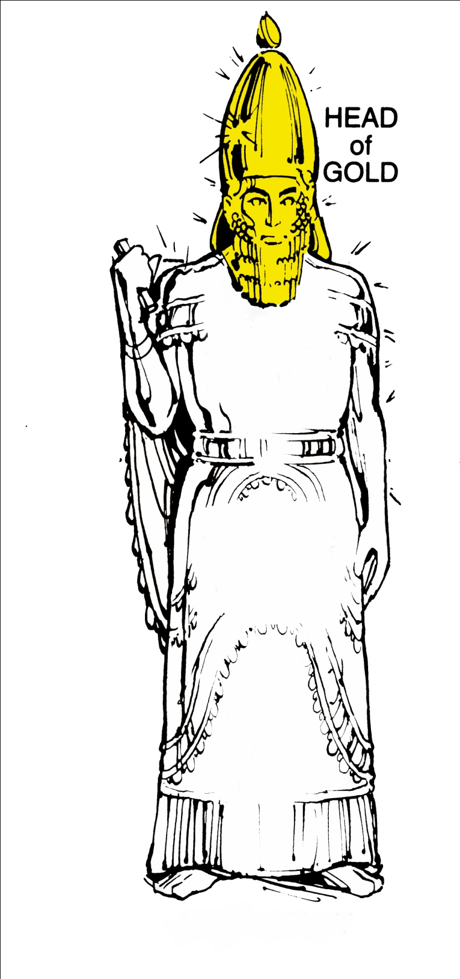
Babylon

Slide 18
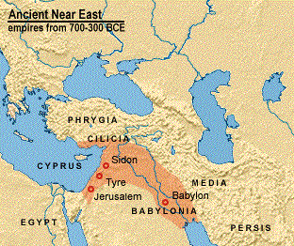
Babylonian Empire 539 BC

Slide 19
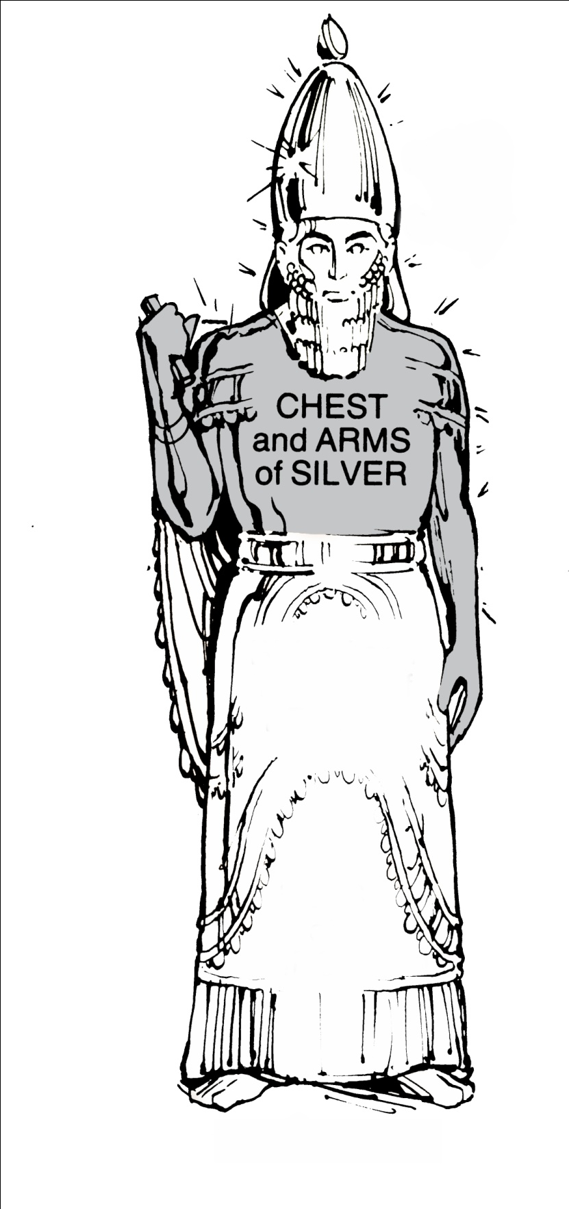
Medo-
Persia

Slide 20
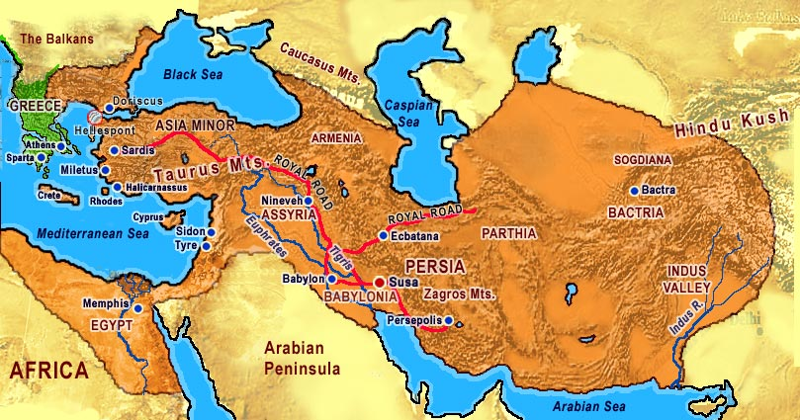
Medo-Persian Empire, 529 BC

Slide 21
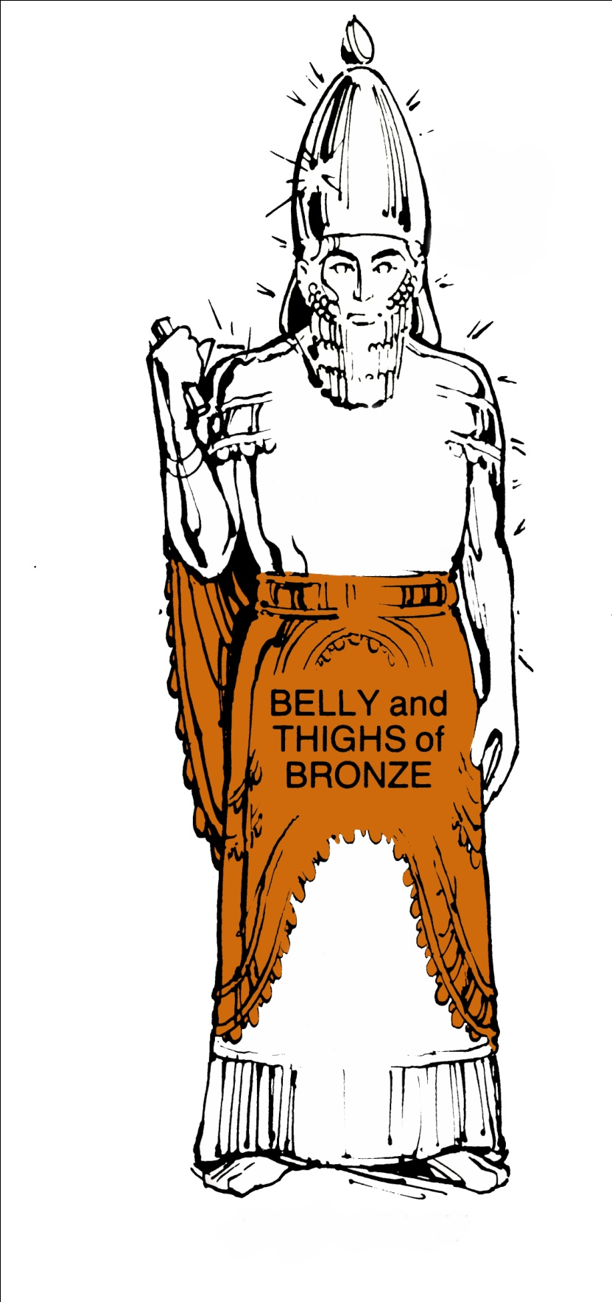
Greece

Slide 22
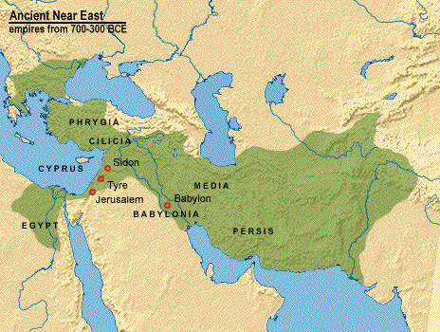
Grecian Empire 323 BC

Slide 23
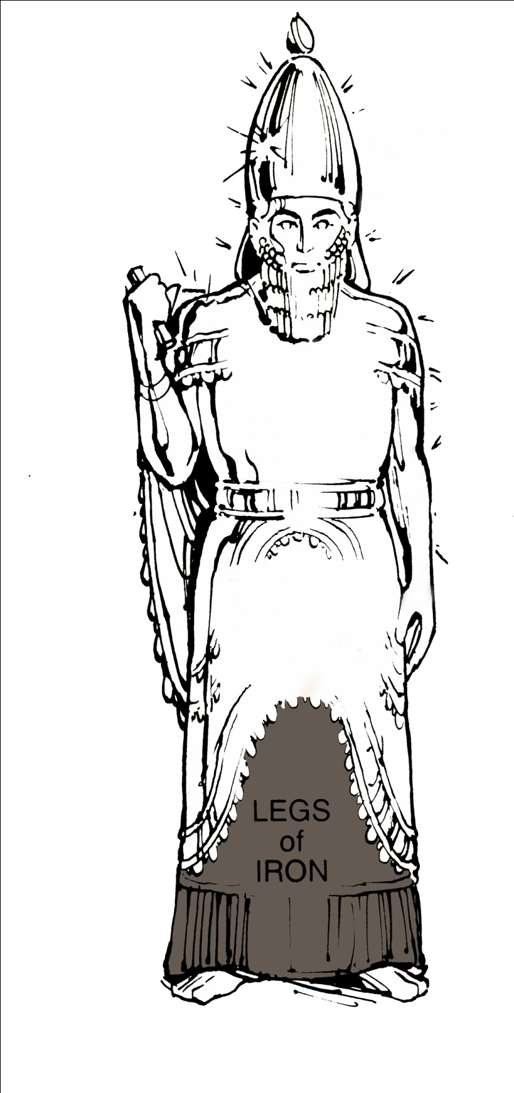
Rome

Slide 24
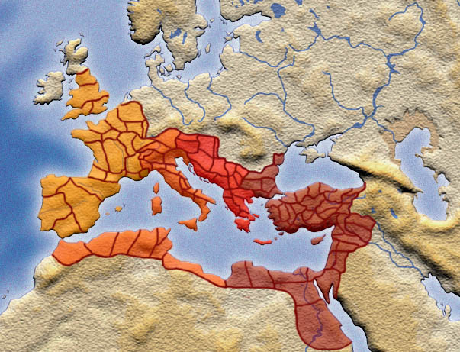
Roman Empire, 337 AD

Slide 25
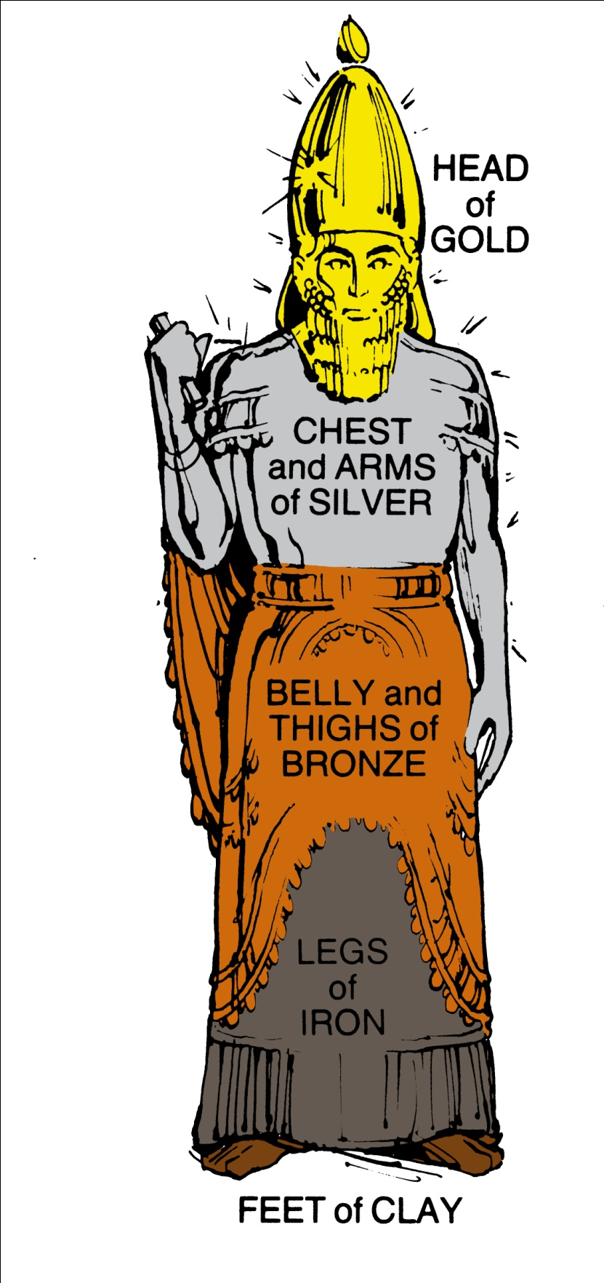
Babylon
Medo-Persia
Greece
Rome

Slide 26
Babylon
606-538 BC
Medo-Persia
538-333 BC
Greece
333-44 BC
Rome
44 BC-476 AD

Slide 27
The Silent Years
There is a 400 year period between the Old and New Testaments
This period is referred to as “The Silent Years”
During this period there is a gap in Biblical record
There is no record of revelation during the Silent Years

Slide 28
400 Silent Years
O.T. N.T.
4000-400 BC 4 BC to 100 AD
Intertestamental Period
400 – 4 BC

Slide 29
